Slide 1
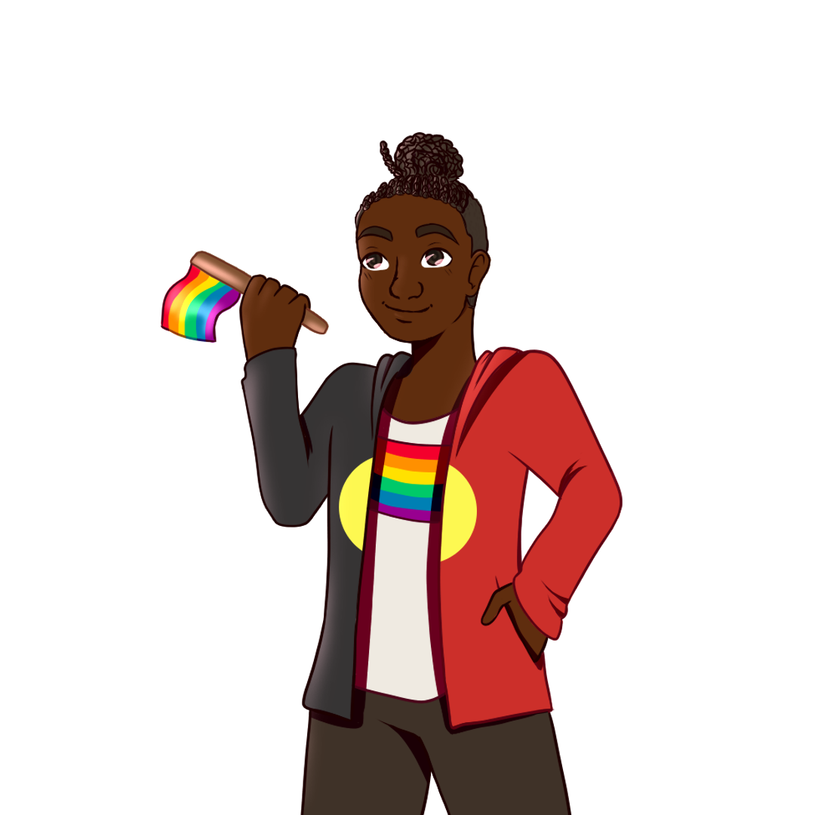
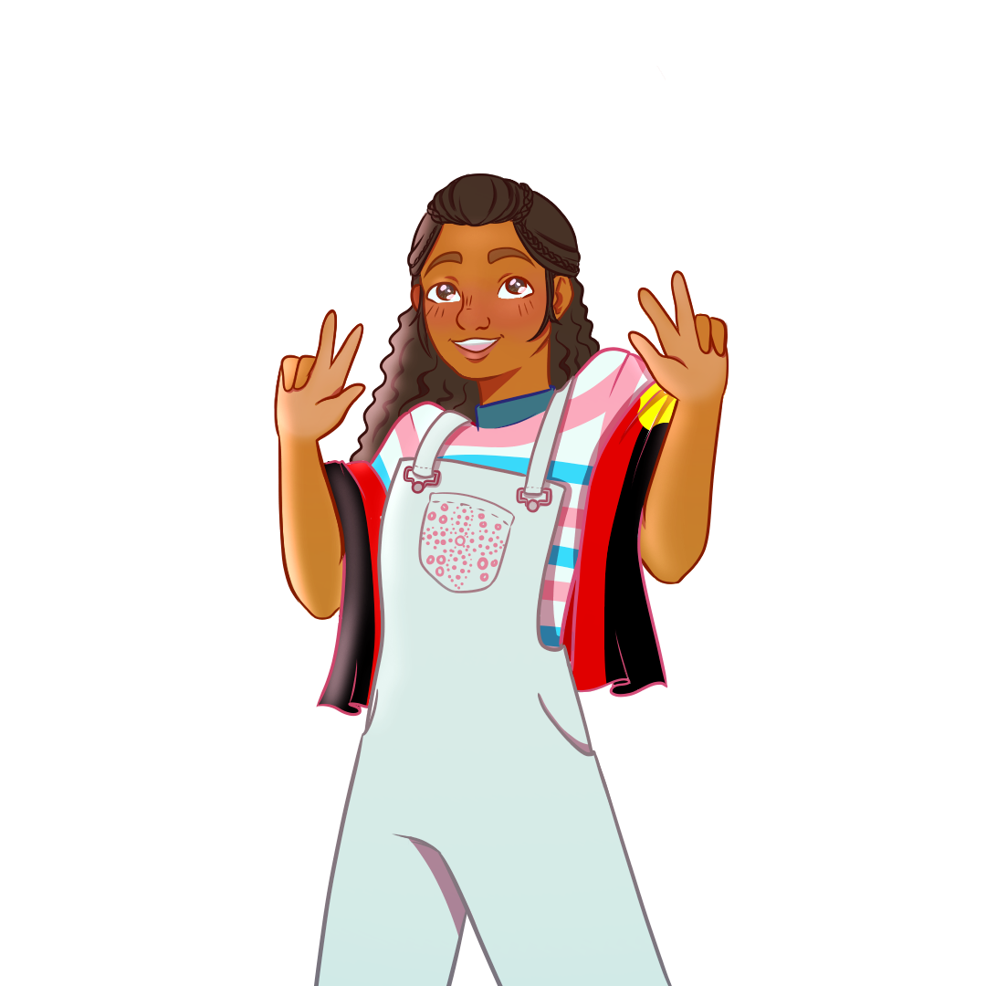
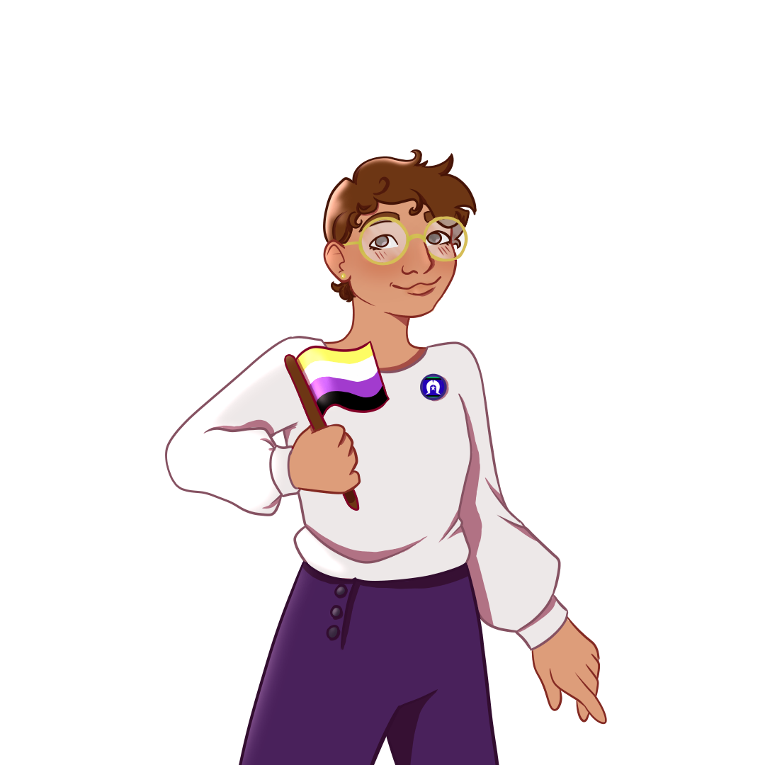
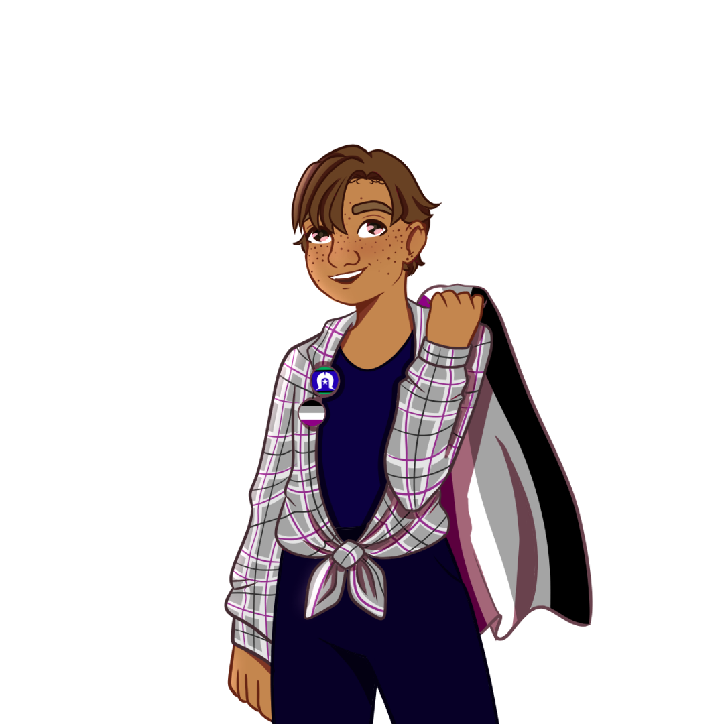
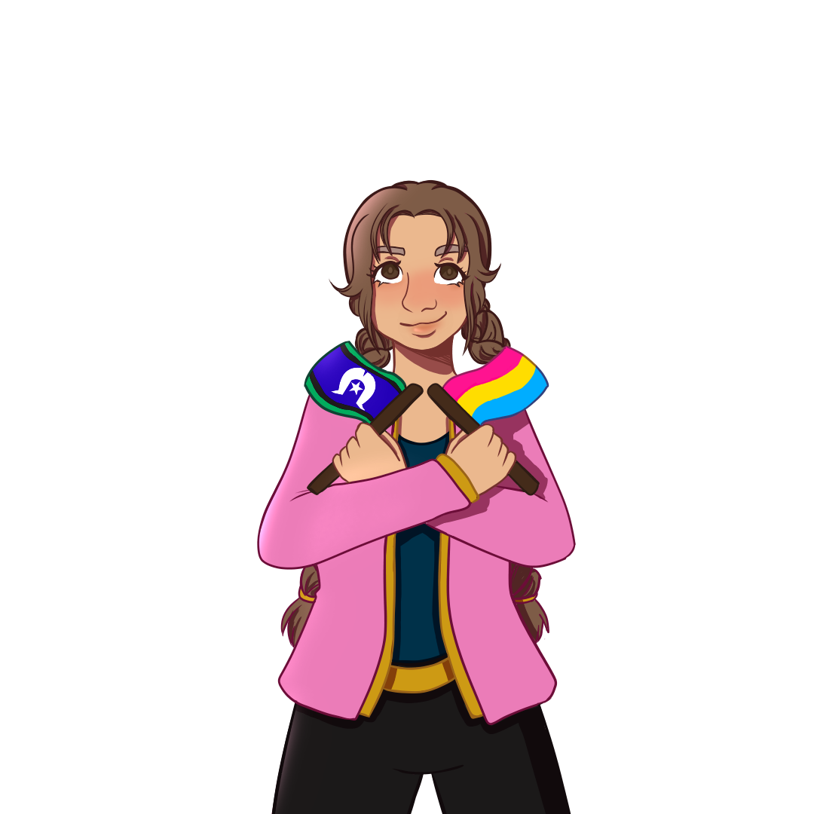
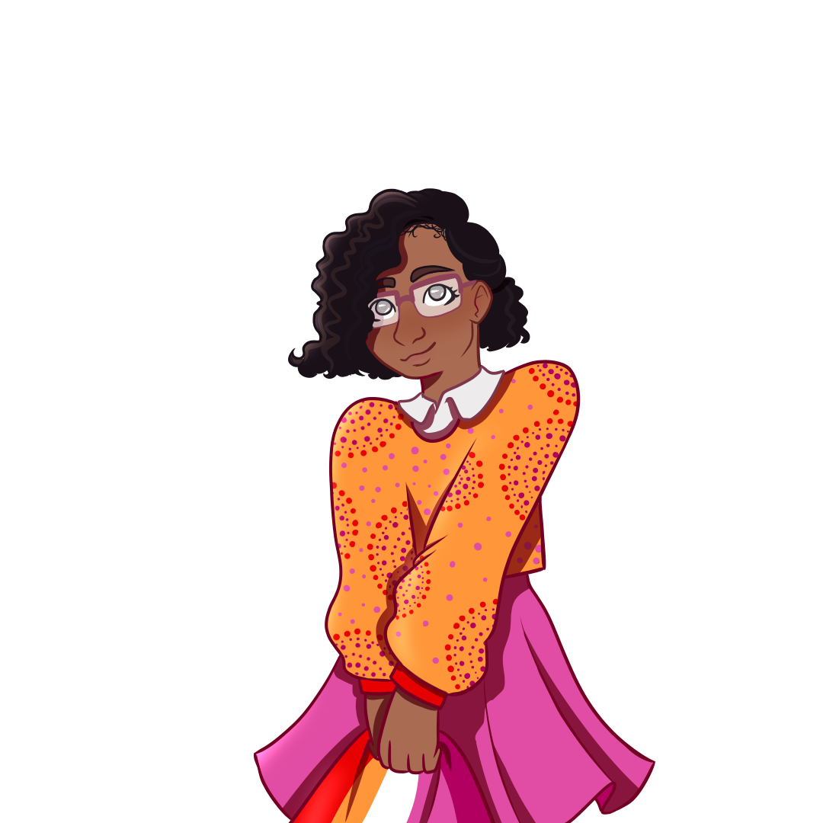
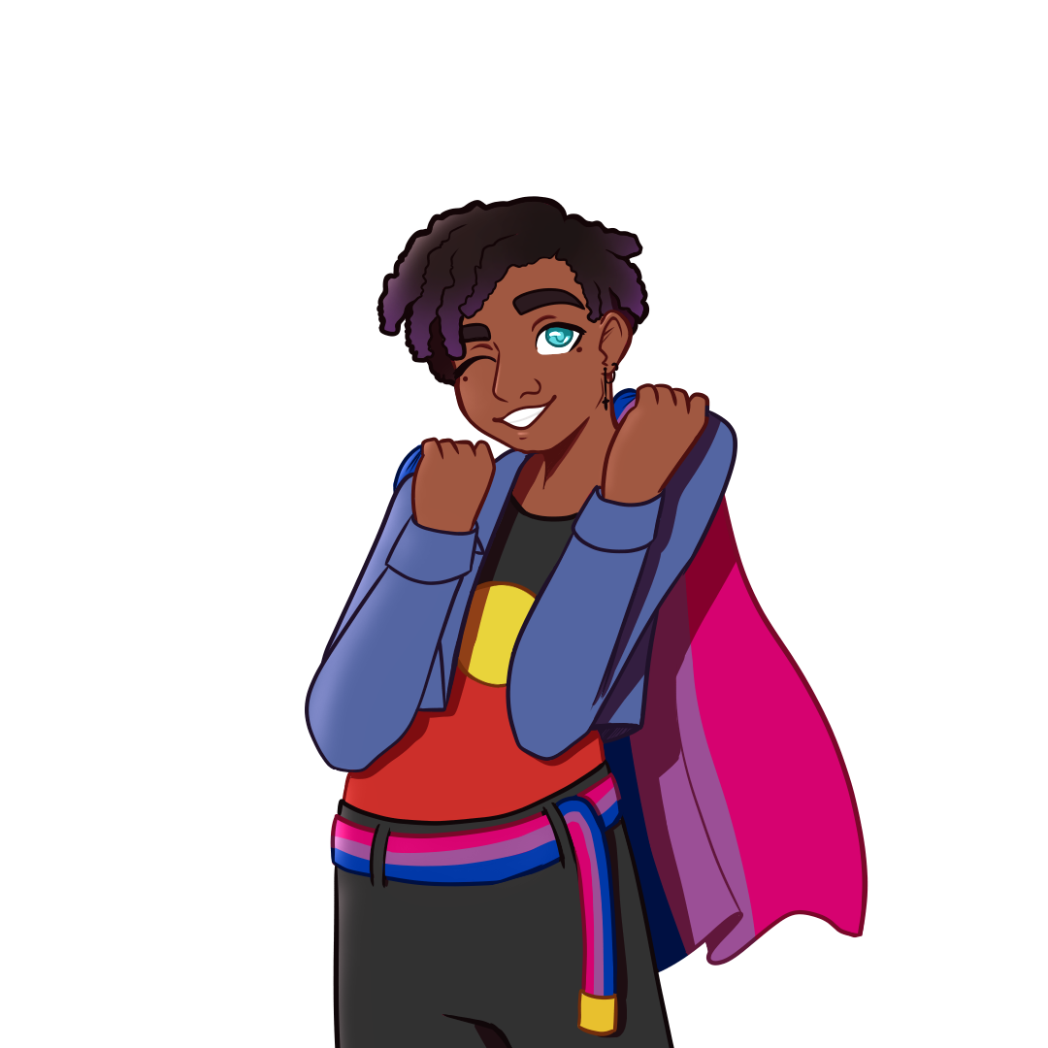
Acknowledgement of Country
I would like to acknowledge that we are learning and meeting here today on Wadjuk Noongar Boodjar (country) and pay my respects to Elders past and present.
I extend my respects to other Aboriginal and Torres Strait Islander people in the room.

Slide 2
National Survey Partner Forum
30th Nov 2022

Slide 3
Content warning
We will be talking briefly about suicide
Lifeline on 131 114 or online (https://www.lifeline.org.au/).
Call the Suicide Call Back Service on 1300 659 467.
For young people 5-25 years, call the Kids Helpline Helpline(https://kidshelpline.com.au/) 1800 55 1800
For resources on social and emotional wellbeing and mental health services in Aboriginal Australia, see:
http://www.sewbmh.org.au/
https://wellmob.org.au/

Slide 4
Forum Objectives
Share preliminary results and analysis of survey data (service use, SEWB, mental health, suicide behaviour)
Check interperation of findings and contextualise findings
Solicit ideas for further data analyses
Rules
Raise your hand to speak
Don’t interrupt while someone else is speaking
Mute yourself if there’s background noise

Slide 5
Forum Overview
Presentation of participant demographics & service use data (20 min)- Shakara Liddelow-Hunt
Group discussion (25 mins)- Braden Hill
Presentation of social emotional wellbeing (SEWB), psychological distress, and suicide behaviour data (20 mins) – Bep Uink
Group discussion (25 mins) – Braden Hill
Discussion of next steps and forum close

Slide 6
Aboriginal and Torres Strait Islander
Phase 1: Yarning groups and interviews
Phase 2: National survey
Phase 3: Co-design
LGBTQA+
Youth
Notes:
Walkern Katatdjin is a study about the mental health of social emotional wellbeing of Aboriginal and Torres Strait Islander LGBTQA+ young people. We know Aboriginal people, LGBTQA+ people, and young people are all at increased risk of poor mental health and wellbeing. The study consists of 3 phases.

Slide 7
National online survey for people who are:
Aboriginal and Torres Strait Islander
LGBTQA+
Aged 14-25 years
Participants(n) = 619
Notes:
National survey was primarily hosted online. Recruitment was through social media, professional networks and services, and a lot of word-of-mouth. Survey was open between Feb and July 2022.

Slide 8
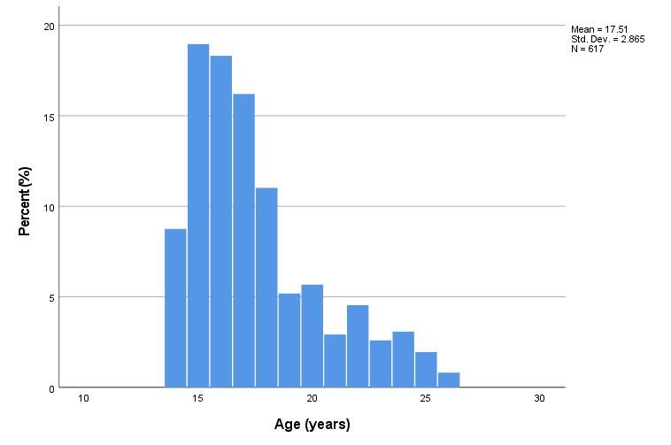
Demographics
 | Frequency | Percent (%)
Aboriginal | 535 | 86.4
Torres Strait Islander | 41 | 6.6
Aboriginal and Torres Strait Islander | 43 | 6.9
Notes:
Our participants were mostly (71%) under 18 years, with average age 17. Most were Aboriginal, 6.6% were Islander and 6.9% were both.

Slide 9
Demographics
Rurality
 |  | Frequency | Percent
Valid | Major City | 235 | 38.0
 | Inner Regional | 140 | 22.6
 | Outer Regional | 109 | 17.6
 | Remote | 18 | 2.9
 | Very remote | 19 | 3.1
 | Total | 521 | 84.2
Missing | System | 98 | 15.8
Total |  | 619 | 100.0
Notes:
Greatest representation from NSW, Qld and Vic. This conforms closely to the number of Aboriginal people in each state and territory, with some overrepresentation from Vic and underrepresentation from NT.
Using postcode data (where a participant provided it) we coded participants into metro, regional (inner, outer), remote and very remote regions based on the Australian Bureau of Statistics classifications. Almost 40% of participants were from a major city and a further 22.% were from a region classes as inner regional. There were 18 remote and 19 very remote participants.

Slide 10
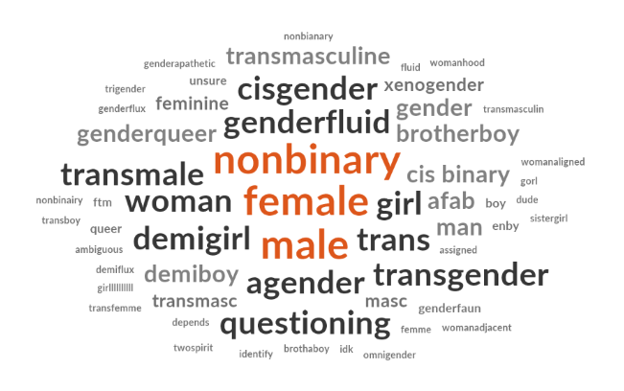
Demographics
Gender | Percent (%)
Woman | 42.8
Non-binary | 35.3
Man | 16.4
Questioning | 2.0
Another identity | 1.1
Gender diversity | Percent (%)
Trans | 46.2
Cis | 45.3
Unsure | 7.8
Prefer not to say | 0.7
Notes:
Gender and sexuality questions were open text, and we’ve coded into smaller categories for analysis. People identified in complex ways that we haven’t 100% captured here. Participants were mostly women and non-binary. Approx half were trans.

Slide 11
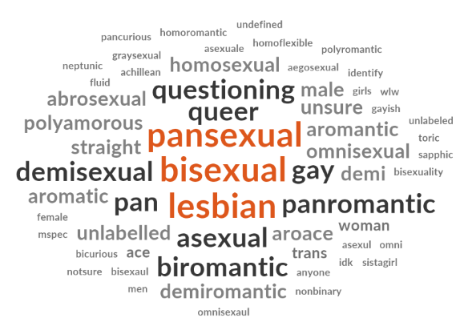
Demographics
Sexuality | Percent (%)
Bisexual/pansexual | 53.7
Gay/lesbian | 20.1
Queer | 11.5
Asexual | 7.5
Questioning | 3.4
Another identity | 3.2
Notes:
Once again, identities were more complex than our analysis can be. Majority of participants were attracted to multiple genders.

Slide 12
Demographics
Living Situation | Frequency | Percent (%)
With parent(s) | 451 | 72.9
Other family | 77 | 12.4
Live with partner(s) | 55 | 8.9
Share house | 45 | 7.3
Live alone | 21 | 3.4
Other | 20 | 3.2
Residential college or boarding school | 16 | 2.6
Foster home | 12 | 1.9
No fixed accommodation | 9 | 1.5
Boarding home | 5 | 0.8
Supported accommodation | 3 | 0.5
Notes:
Most participants were living with parents or other family. Encouragingly, a very few had no fixed accommodation.

Slide 13
Service Use and Experiences

Slide 14
Service Use

Slide 15
Aboriginal Community Controlled Health Organisations
“In my community my aboriginal health service is amazing and most of the workers are my family so they know who I am and where I come from, they know my identity and they respect it, there is also many staff members who identify with being LGBTQA+”
Participants under 16 years old were less likely to tell ACCHOs they were LGBTQA+, and less likely to feel that they were treated equally as an LGBTQA+ person.
Trans participants were less likely to feel that it’s not important to tell ACCHOS there were LGBTQA+.
Notes:
We also ran all of these to see if there were differences depending on age or gender diversity, and I’ve included a note when there are differences.
Question was scored strongly disagree – strongly agree. Agree/strongly agree responses are shown here. It’s worth keeping in mind that a significant number of scores were ‘neutral’.

Slide 16
Aboriginal Community Controlled Health Organisations
Trans participants were more likely to report feeling like ACCHOs made them feel like they matter less because they are LGBTQA+.
“i’m nonbinary but am often called miss and ma’am and it just makes me feel very uncomfortable, and when i say my pronouns are they/them people look really confused so to deal with this, when i have to see the doctor i’ll dress as feminine as possible and pretend i’m a girl for the day just to get through.”

Slide 17
Aboriginal Community Controlled Health Organisations
Nothing
A lot
*Measured on a scale of 1-5 where 1 = nothing and 5= a lot.

Slide 18
Aboriginal Community Controlled Health Organisations
Is there anything else you'd like to tell us about your experiences with Aboriginal and Torres Strait Islander health services and/or resources?
Good service (generally)*
ACCHOs were LGBTQA+ inclusive*
Unsure about LGBTQA+ inclusion*
Bad service (generally)
Don’t assume people are heterosexual and cisgender
Not enough LGBTQA+ women’s health
Worried about LGBTQA+ discrimination
“My experiences with Aboriginal and Torres Strait Islander health services have always been good. I’ve felt seen, respected and felt a sense of belong.”
“They were really accepting and helped me with my every need”
“I’m not out, so I’ve never experienced anything really”
“Have had people assume I’m still sexually active with men even when with a woman. They assume I am unfaithful to my wife and ask in appropriate questions about men.”
“Generally I've found that everyone seems to be inclusive, however, it seems that there are 1 or 2 designated 'champions' for LGBTQA+ peoples. Not everyone will ask for pronouns, it's generally those who are either LGBTQA+ themselves or the 'champions'/allies. Specifically the GP's I've found don't necessarily ask for pronouns etc but sexual health nurses are all over it!”
Notes:
Generally, the majority of participants felt they’d received good service at ACCHOs. That included saying that ACCHOs were LGBTQA+ inclusive, and an important part of that was being treated with respect. Others were concerned that they’d been assumed to be cishet, and a several commented that they hadn’t been asked for their pronouns. A small number (n=2) were worried about being discriminated against or felt the LGBTQA+ health guidance was focused on men (n=2). Also 9 participants specifically commented that they weren’t ‘out‘ at services so they were unsure. Bad service included lack of compassion, discrimination (above), or being refused service.
*most frequent responses

Slide 19
Aboriginal Community Controlled Health Organisations
What are the main reasons that you have NOT used an Aboriginal and Torres Strait Islander health service?
Don’t need to*
ACCHOs are inaccessible*
Transport
Lack of services in area
Waitlists and time
Don’t know about them*
Don’t feel “Indigenous enough”*
Disconnected from Aboriginal and Torres Strait Islander community
Negative experience in ACCHO
Fear of anti-LGBTQA+ discrimination
Fear (reasons unknown)
Parents
Use other services
“I haven’t really felt the need to.”
“Process of getting help I need takes far too long.”
“Don't have one where I live.”
“I am unsure of what options there are/where I can find then.”
“I’m not officially recognized as Aboriginal by the government and scared of being reprimanded or told I’m “not Indigenous enough””
“Feel like sometimes I'm not 'Aboriginal enough' to use these services.”
“Afraid to.”
“Mum and dad don’t let me.”
“I already see a good doctor and didn’t feel the need to move.”
Notes:
Only 2 participants reported a negative experience in ACCHOs. Only 1 participant stated they didn’t want to go to ACCHOs because of fear of LGBTQA+ discrimination, but multiple others responded that they were afraid without explaining why.

Slide 20
Aboriginal Community Controlled Health Organisations
Approx. half of participants felt safe and comfortable using ACCHOs as an LGBTQA+ person, BUT ACCHOs level of knowledge about providing care to LGBTQA+ people was generally low
64% of participants found that ACCHOs did not use the right language for LGBTQA+ people.
23% of participants heard rude comments about their LGBTQA+ identity.
Similarly, while many participants reported positive experiences in ACCHOs, there remains a need to improve staff knowledge about LGBTQA+ people.
The main barriers to attending ACCHOs were:
Not needing to attend*
Accessibility
Feeling ‘not Indigenous enough’

Slide 21
LGBTQA+ Services
Participants under 16 years old were significantly less likely to tell the service they were Aboriginal compared to people over 16 years.
“My experience with the LGBTQIA+ services that I have gone to so far have been fairly good.”

Slide 22
LGBTQA+ Services
“You rock up and already they look at you funny for being Aboriginal, but then if you add any concerns around STIs or alcohol/drug problems either from yourself or family it always feels as though they're thinking "oh yeah, of course they're dirty or a druggo, they're Aboriginal".”
Participants under 16 years old were significantly more likely to be refused service because they are Aboriginal and/or Torres Strait Islander and significantly less likely to feel like services listened to their opinion on involving family or friends in their care.

Slide 23
LGBTQA+ Services
Nothing
A lot

Slide 24
LGBTQA+ Services
Is there anything else you'd like to tell us about your experiences with LGBTQA+ health services and/or resources?
LGBTQA+ services are racist*
Indigeneity disregarded by services
Need Aboriginal staff
Received good service and respect
Need outreach into remote communities
“There are a few services in the cities that are really good with LGBT mob, but a lot of the country or regional services are abysmal…But the city is way too far for a lot of regional/country mob to try and access equal and empathetic healthcare, so a lot of us just don't go and get LGBT specific help.”
“even after telling them i was indigenous they marked me as not indigenous several times”
“It should be a requirement that people working in health receive regular training for cultural diversity, with specific context around working with Aboriginal & Torres Strait Islander people. I am sick of all experiencing racism..”
“My experience with the LGBTQIA+ services that I have gone to so far have been fairly good, I think I get treated with the right amount of respect and they do genuinely care for my wellbeing”
“I think health services really need to keep up with education…Remote communities need a lot more support.”

Slide 25
LGBTQA+ Services
What are the main reasons you have NOT used an LGBTQA+ health service?
Don’t know about them*
Don’t need to*
LGBTQA+ services are inaccessible*
Scared or uncomfortable*
Feel like they don’t deserve service
Not ‘out’ and/or unsure of identity
Parents
Use other services
White people
Never thought about it
“…I don’t really know what that is 🤨..?
“I haven't needed them.”
“There aren't any in town.”
“I haven’t really had the courage to do so.”
“I am still a minor, therefore I need my mother to drive me places, and I am not yet out to my Mother nor anyone who can drive.”
“I do not want to be stopped by my parents.”
“I’m not out”
Notes:
Inaccessibility was primarily no LGBTQ services in area.

Slide 26
LGBTQA+ Services
Approx. half of participants felt safe and comfortable using LGBTQA+ services as an Aboriginal or Torres Strait Islander person
43.3 % of participants heard rude, hurtful or ignorant comments about their Aboriginal and Torres Strait Islander identity
Many participants reported experiences of racism in LGBTQA+ services
Participants also stated that their cultural identity was disregarded by staff and that services needed to hire more Aboriginal and Torres Strait Islanders staff
The main barriers to attending ACCHOs were:
Not knowing about them
Not needing to attend*
Inaccessibility

Slide 27
General Health Services
Participants under 16 years old were significantly less likely to tell services that they are Aboriginal and Torres Strait Islander and LGBTQA+.
Trans participants were significantly more likely to expect to have a bad experience with services, less likely to feel comfortable using services, less likely to feel respected by staff, and less likely to report services understood their health needs.

Slide 28
General Health Services
“Don't know basic things like CTG (close the gap) and being non-binary etc.”

Slide 29
General Health Services
Nothing
A lot

Slide 30
General Health Services
Is there anything else you would like to tell us about your experiences at general health services and resources?
Received good service
Ignorant about Aboriginal health
Ignorant about LGBTQA+ health
Rarely know how to be inclusive of Aboriginal and LGBTQA+
Rude or condescending
Assumed cisheterosexuality
Too clinical
More visible acceptance needed
Not ‘out’
Feel scared or uncomfortable
“I find that general services are more respectful.”
“They where always so nice I never felt uncomfortable”
“‘Medically they know about Aboriginal and/or Torres Strait Islanders and/or those who identify being LGBTQA+ but to my knowledge and experience I feel they do not understand who we are and the communication towards us, I’ve found myself belittled and made as though I do not know a lot”
“I’ve been called slurs and refused service assuming that I used meth because I am Indigenous”
“Pretty rude all round…”
“A lot of the time I mention that I’m indigenous just not that I’m LGBTQIA+ because I’m afraid I’ll be treated less than or discriminated against”
Notes:
‘Good service’ was mainly described as being treated with respect. Participants who felt scared or uncomfortable states that is was because they were afraid of being discriminated against for being LGBT and/or they felt uncomfortable in services in general

Slide 31
General Health Services
What are the main reasons you have NOT used a general health service?
Don’t know about them
Don’t need to
Haven’t got around to it
Haven’t had the chance
Scared or uncomfortable
Use other services
“Idk”
“I don’t want to bother people and to scared to”
“I just haven’t thought about it and I haven’t really looked into it.”
“I don’t like talking about myself over and over to all types of different people”
“I go to aboriginal health services.”
“Didn't think I needed to”
Notes:
Low number of responses to this questions, given that most participants had attended general health services.

Slide 32
General Health Services
General health services were the most attended of all services
Nearly half of participants felt comfortable using general health services and felt that they were respected by staff and treated equally
Some participants reported very positive relationships with clinicians at general health services
However, there is a need for improved staff knowledge and visibility at general health services
43.7% of participants reported that staff did not use the right language for Aboriginal and Torres Strait Islander LGBTQA+ people
31.3% of participants heard rude, hateful or ignorant comments about their Aboriginal and Torres Strait Islander LGBTQA+ identity
Participant comments reinforce that there is poor knowledge about both Aboriginal and Torres Strait Islander and LGBTQA+ care
Additionally, general health services were reported to be rude or condescending

Slide 33
Service use by Regionality:
Service Use
Metro Inner Regional Outer regional Remote Very remote
General Health Service Use | 158(94.6%) | 96(90.6%) | 71 (85.5%) | 14(93.3%) | 14(87.5%)
Aboriginal Health Service Use | 94 (55.6%) | 48(44.4%) | 48(55.8%) | 5(29.4%) | 7(43.8%)
LGBTQA+ Health Service Use | 43(24.6%) | 30(27.5%) | 19(22.1%) | 4(23.5%) | 1 (6.3%)
Online information & support | 88(55.7%) | 46(45.5%) | 36(45.6%) | 12(80%) | 6 (42.9%)
n = 'yes' responses (% of valid responses)
Use of General Health Services did not differ substantially across regions, but was lowers in Outer Regional areas
Lowest use of Aboriginal Health Service was in Remote regions
Lowest use of LGBTQA+ Health Service was in Very Remote regions
Highest use of online information and support was in Remote regions
Notes:
This table shows total 'yes' responses (% of valid responses) to use of each service type.
Use of General Health Services did not differ substantially across regions
Lowest use of Aboriginal Health Service was in Remote regions
Lowest use of LGBTQA+ Health Service was in Very Remote regions
Highest use of online information and support was in Remote regions

Slide 34
Aboriginal Health Service use by state/territory:
Service Use
Notes:
TAS had lower rate of Aboriginal health service use than other states (25% versus 45-55% in other states/territories).

Slide 35
LGBTQA+ Health Service use by state/territory:
Service Use
Notes:
Highest % of LGBTQA+ service use was in ACT BUT this was only 3 participants. More meaningful participation in these services was found in VIC and SA.

Slide 36
General Health Service use by state/territory:
Service Use
Notes:
No real differences across states/territories.

Slide 37
Online Service Use
What supports were young people accessing online?
Resources
Service websites
Social media
Telehealth or online care
Youtube
What were young people using online supports for?
Feeling strong and seen
Friends and community
Information, education and research
Kindness and support
What were the problems?
Unreliable information
Other problems

Slide 38
Service Use
If you want to, tell us how health workers can do better for Aboriginal and Torres Strait Islander LGBTQA+ people?
Ask pronouns
Don’t assume heterosexual/cisgender/white
Diverse staff
Education and training
Treated with respect
Visibility
Resources for Aboriginal LGBTQA+ mob
Be less clinical

Slide 39
Summary:
Service Use
High use of general health services, but high preference for going to LGBTQA+ or Aboriginal Health Services as well
Similar levels of positive and negative experiences in all service types, room to grow and improve in each particularly around knowledge of young peoples’ needs
Experiences of racism in LGBTQA+ Services, fewer participants reported homophobic or transphobic discrimination in Aboriginal Health Services
Participants reported experiences of ignorance or invisibility in General Health Services
Generally not large differences in service use across regions and states
Some differences in experiences based on age and gender diversity

Slide 40
Discussion

Slide 41
Questions
What are each of your initial thoughts on findings about Aboriginal and Torres Strait Islander LGBTQA+ young peoples’ service use/experiences?
Were there any findings that surprise you or seemed counter-intuitive?
Is there anything you’d like us to explore in more depth? (Is there anything you want to know more about /that you would like clarity on? E.g., group comparisons (age, state, etc.)

Slide 42
Part 2- SEWB and Mental Health

Slide 43
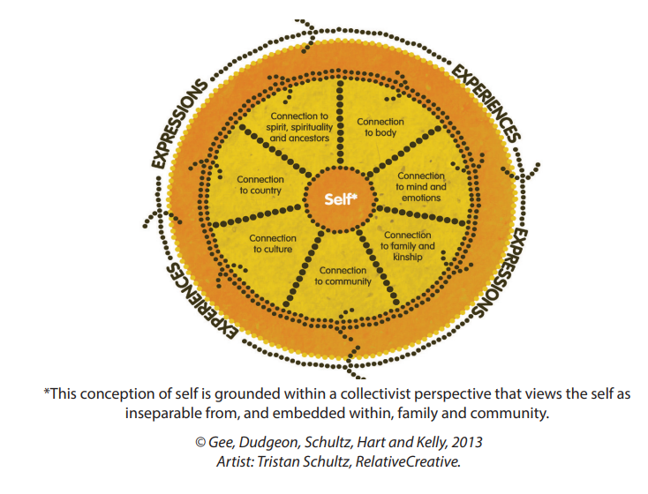
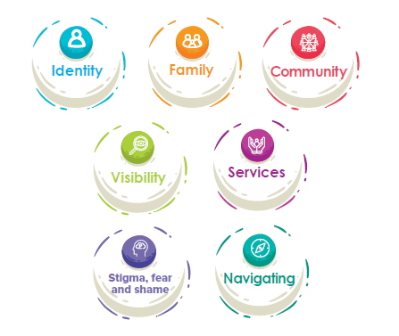
Survey Design
Notes:
In doing this survey, we were informed by Gee et al.’s model of SEWB and our own Phase 1 findings.

Slide 44
Average levels of connection to spirit and ancestors, connection to mind and emotions, family & Kinship connection to culture, country, and physical health, were moderate to low.
"I feel a sense of connection to my spirit & ancestors" : Mean = 4.22 (on a scale of 1 = not at all; 10 = very much)
Inner Peace Subscale of the Growth Empowerment Measure (Connection to Mind and Emotions): Mean = 4.179 (on a scale of 1 = not at all; 10 = very much)
"I feel like I belong to my people's land/waters": Mean = 2.397 (on a scale where 0 = not all all; 4 = very much)

Slide 45
"how often you spend time trying to learn about Aboriginal and/or Torres Strait Islander culture, such as its history, traditions, language and customs.": Mean = 2.448 (on a scale where 0 = never; 4 = very often)
"how often you take part in Aboriginal and/or Torres Strait Islander cultural practices": Mean = 1.533 (on a scale where 0 = never; 4 = very often)
"My family gets along well together": Mean = 2.833 (on a scale where 1 = strongly disagree; 5 = strongly agree)
"I have a strong sense of kinship/family links.": Mean = 3.225 ((on a scale where 1 = strongly disagree; 5 = strongly agree)
"How would you rate your overall health?" Mean = 5.052 (on a scale of 1 = poor health to 10 = excellent health]

Slide 46
Some positive findings….
family relationships were seen as important to participants
"My relationships with my family are important." Mean = 4.062(on a scale where 1 = strongly disagree; 5 = strongly agree)
drug and alcohol use and impact was low
49.4% of participants (n = 230) never used alcohol or drugs and 30.3% (n = 141) used montly or less. Only 5.2% (n = 24) used 4 or more times a week.
61.4% (n = 145) of participants said their life was 'not at all' or 'not really' made worse by their use of alcohol or drugs. Only 5.9% (n = 24) said their life was mad a lot worse by their alcohol or drug use.

Slide 47
Social and Emotional Wellbeing
I feel I belong to…
*Participants were asked to respond to each item on a scale of: strongly disagree, disagree, neutral, agree, strongly agree
Notes:
When asked which communities young people felt they belonged to, again on a scale of strongly disagree to strongly agree, they mostly agreed they belonged to the LGBTQA+ community, with mixed feelings about other communities they might belong to.
If we go back to our previous table, we’d note that higher community acceptance → higher belong in LGBTQA+ community and higher Elder acceptance → higher belonging in Aboriginal community.

Slide 48
Several protective factors for SEWB outcomes
Pride in Aboriginal identity was associated with…
more frequent participation in community (all communities) events
greater feelings of belonging to an Aboriginal community and to an Aboriginal/LGBTQA+ community
more time spent trying to learn about culture
more time spent in cultural activities
greater connection to ones lands/waters
family relationships being rated as more important, greater sense of family and kinship bonds
stronger connection to spirit & ancestors.

Slide 49
Several protective factors for SEWB outcomes
2) Parent/caregiver acceptance of LGBTQA+ identity was associated with..
higher Inner Peace, family getting along better, greater importance of family relationships and stronger family and kinship bonds.
Acceptance of LGBTQA+ by Elders was associated with higher feelings of belonging to an Aboriginal and Torres Strait Islander community, and more time trying to learn about culture, more time spent engaging in cultural practices.
These are all malleable factors that we can help change.

Slide 50
Social and Emotional Wellbeing
I feel that me being LGBTQA+ is accepted by…
*Participants were asked to respond to each item on a scale of: strongly disagree, disagree, neutral, agree, strongly agree
Notes:
We asked if different people were accepting of their identity, on a scale of strongly disagree to strongly agree, and had generally positive responses. Parents and siblings were most accepting, responses about extended family, community and Elders were largely neutral.

Slide 51
Social and Emotional Wellbeing
Relationships racism → higher wellbeing
Racism from LGBTQA+ people → higher wellbeing
Experiencing homophobia/transphobia from Aboriginal and Torres Strait Islander community → lower wellbeing
Disability → lower community belonging and connection to Culture

Slide 52
Social and Emotional Wellbeing
If so, why?
Moved to access healthcare, education, career or other infrastructure*
Family decided to move*
Never lived on Country*
Stolen Generations or Removal
Connections made off Country
Not sure where Country is
Unsure why
Safety concerns on Country (1)
Notes:
*most frequent responses

Slide 53
Social and Emotional Wellbeing
If you want, please tell us some ways in which you stay connected to Aboriginal and Torres Strait Islander culture.
Participants stayed connected to Culture by doing:
Art
Ceremony
Connect to Country and environment
Dance
Events
Food
Learning history
Learning language
Learning stories
Music
Other learning
Spend time with community
Spend time with family
Sport
Support artists/musicians
Social media
Weaving
These connections were facilitated by:
Community
Elders or knowledge holders
Family
Friends and other young people
School or university
Services
Social media
Work
*18 participants stated that they didn’t connect to Culture in any way.

Slide 54
Health Promoting Factors
Notes:
Thinking back to the themes identified in phase 1, visibility was one of the things people said made them feel strong in their identity. Similarly, participants in the survey agreed that fair representation in the media is important and makes them feel strong and seen, but they didn’t feel they were often represented.

Slide 55
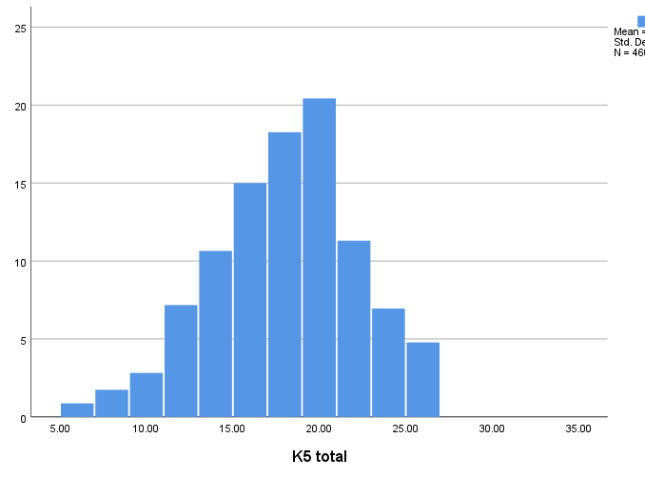
Mental Health
Mean = 17.46
Std. Dev. = 4.181
N = 460
*Psychological distress measured by 5 items – how often participants felt: nervous, without hope, restless or jumpy, everything was an effort, sad
Notes:
To look at mental health, we assessed psychological distress using the Kessler-5 scale (validated with Aboriginal young people). A high score indicates a high level of distress.

Slide 56
Mental Health
92%
77%
Mean = 17.46
Std. Dev. = 4.181
N = 460
68% (N = 320) had experienced a lifetime history of Depression.
*Psychological distress measured by 5 items – how often participants felt: nervous, without hope, restless or jumpy, everything was an effort, sad
Notes:
A score above 12 indicates high distress and above 15 indicates very high distress, and the vast majority of participants sat in the high/very high range.

Slide 57
Mental Health
In your lifetime, have you ever attempted suicide?

Slide 58
Mental Health
During the past 12 months, did you ever seriously consider attempting suicide?
Of those who said ‘yes’…
70% had made a plan
During the past 12 months, did you make a plan about how you would attempt suicide?
Of those who said ‘yes’…
45% had attempted
During the past 12 months, have you attempted suicide?
Notes:
This is a breakdown of suicidal ideation, plan and attempt in the last 12 months. In the last 12 months, nearly 57% had seriously considered suicide. 42% of all participants had made a plan. 19% of all participants had attempted in the past 12 months. A high percentage of suicidal ideation is fairly normal among young people, intent and plan is not.
If the 57% who had experienced suicidal thoughts, more than 70% had made a plan, which works out to about 42% of all participants who answered these questions. Of those, 45% had attempted, meaning that 19% of all young people in the study had attempted in the last 12 months.

Slide 59
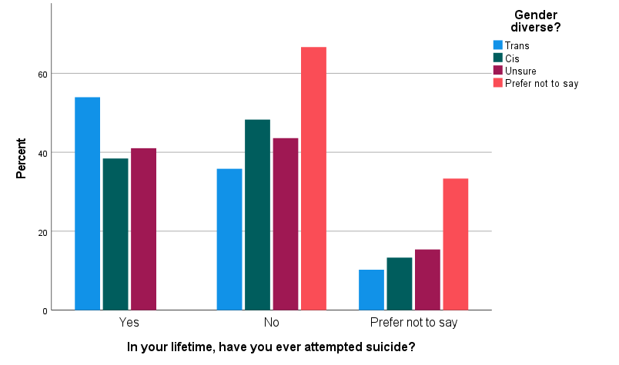
Mental Health
Notes:
This was considerably worse among trans participants, shown in blue here, which lines up with other LGBTQ+ studies.

Slide 60
Strengths

Slide 61
Pride

Slide 62
Pride
Please tell us some good things about being an Aboriginal and/or Torres Strait Islander LGBTQA+ young person?
“I get to celebrate my identity and feel close with multiple communities in which I exist in…”
“It's nice to be able to find such a fundamental connection with another person so quickly…”
“My identity shapes me as a person, and gives me an incredibly unique world view.”
“Queerness is ingrained in the history of so many native cultures, and in decolonising my world view and view of myself I have become prouder of my LGBTQ identity as an Indigenous person.”
“The community and people you find kinship with are the most important and positive part to me.”
“I'm deadly!!!!!!!!!!!”
Supportive friends and community*
Identity gives them a unique perspective*
LGBTQA+ identity challenges colonial narratives
Opportunities to educate others
“I’m deadly”
Identity makes them open minded and better understand others
Part of a rich culture
Being their true self/finding themself
HOWEVER
Some participants discussed both good and bad things
Some participants responded that there was “nothing good”
Notes:
The “I’m deadly” code indicates participants saying they’re cool and nothing else

Slide 63
Discussion
1) Again, overall thoughts on the findings?
2) What do you see as the opportunities for implementation?
3) Are there any sensitivities we need to take into account when publishing the data?

Slide 64
Next Steps
Elders forum (early 2023)
Community webinar once findings finalised (early 2023)
Community Report (mid 2023)

Slide 65
Research team: Dr Bep Uink, Shakara Liddelow-Hunt, Prof Braden Hill, Prof Ashleigh Lin, Dr Yael Perry
Artist: Skye Milton
Telethon Kids Institute, Kulbardi Aboriginal Centre (Murdoch University), Edith Cowan University
The ethics of this research project have been approved by:
Western Australian Aboriginal Health Ethics Committee (WAAHEC) #1000
Department of Health and Menzies School of Health Research Top End HREC (TEHREC) #2021-3997
Central Australian Health Research Ethics Committee (CAHREC) #2021-3997
Aboriginal Health Research Ethics Committee (AHREC) #04-21-924
Aboriginal Health and Medical Research Council NSW (AH&MRC) #1787/21
Australian Institute of Aboriginal and Torres Strait Islander Studies (AIATSIS) #EO231-20210114
ACON Research Ethics Review Committee #202118
This project is funded by the National Health and Medical Research Council (NHMRC)

