Slide 1
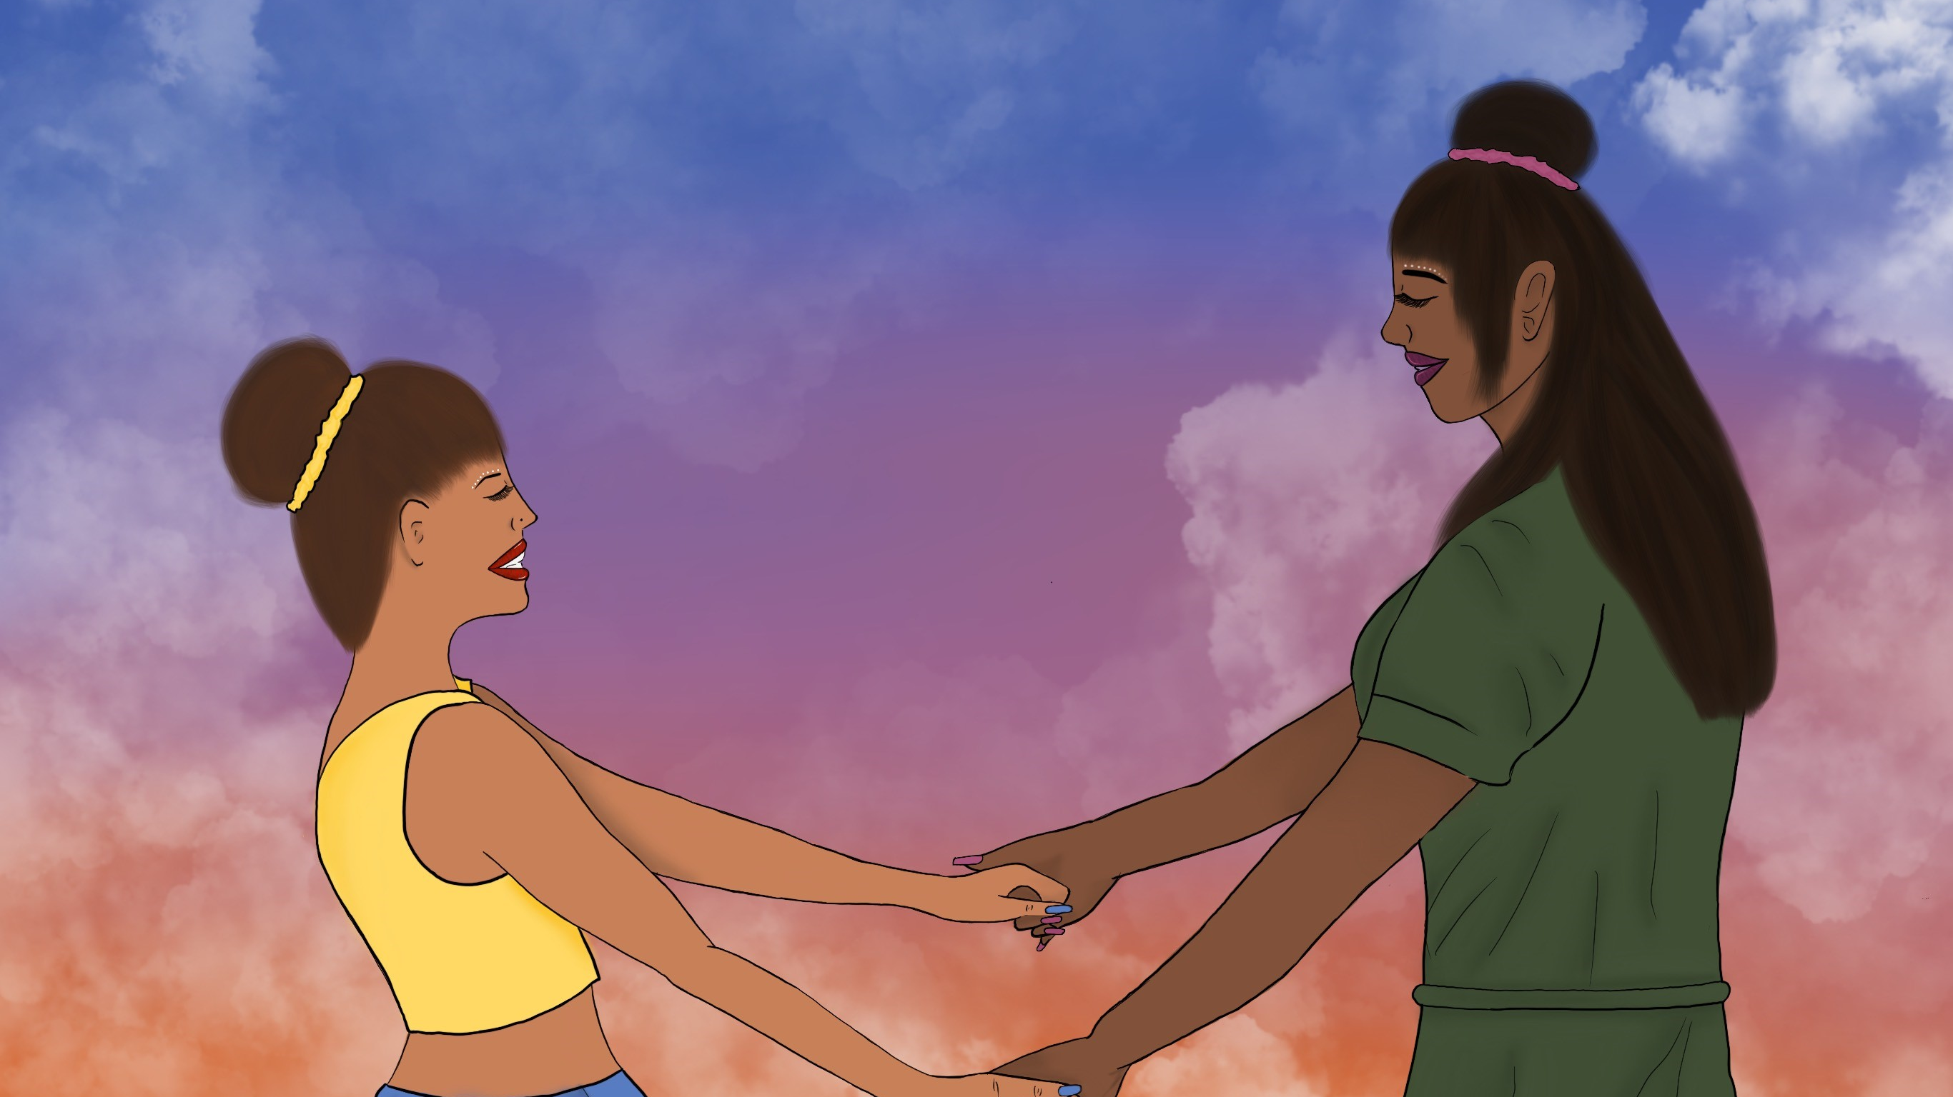
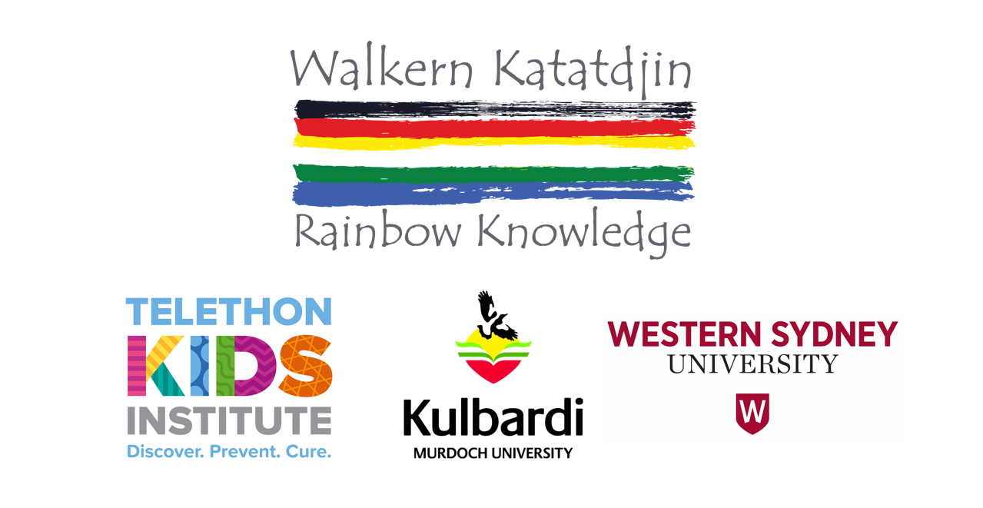
Identity and wellbeing among Australian Indigenous LGBTQA+ youth
Dr Bep Uink & Shakara Liddelow-Hunt
ABORIGINAL AND TORRES STRAIT ISLANDER RESEARCH SHOWCASE
SOUTH AUSTRALIAN HEALTH AND MEDICAL RESEARCH INSTITUTE 27TH-28TH FEB, 2020
Dr Bep Uink, Kulbardi Aboriginal Centre, Murdoch University, Telethon Kids Institute, WA
b.uink@Murdoch.edu.au
Shakara Liddelow-Hunt, Telethon Kids Institute, WA
shakara.liddelow-hunt@telethonkids.org.au
https://www.rainbowknowledge.org/
Notes:
Presentation is mainly about initial findings from the project.

Slide 2

Project Overview
Walkern Katatdjin is a national research project that aims to understand and promote the mental health and wellbeing of Aboriginal and/or Torres Strait Lesbian, Gay, Bisexual, Transgender, Queer/Questioning and Asexual young people, and to work with services to develop appropriate interventions.
3-year study, funded by National Health and Medical Research Council
Perth, Greater Western Sydney
Partnered with Yorgum Aboriginal Corporation, Wungening Aboriginal Corporation, National Centre for Indigenous Excellence (NCIE) and ACON
Aboriginal LGBTQA+, Aboriginal and LGBTQA+ people represented on research team

Slide 3

Need for this research
Advocates raising concern about suicide, distress, homelessness, and violence in this community
Very little empirical research in national and international literature
Potential benefits
  Greater inclusion within Aboriginal and LGBTQA+ communities means broader engagement with services for LGTBQA+ Aboriginal youth
  Also means survival and participation in Aboriginal culture
  Lowered risk for psychological distress and harm among LGBTQA+ Aboriginal youth
  Social inclusive health care and supports that are mindful of what it is like living at this intersection

Slide 4
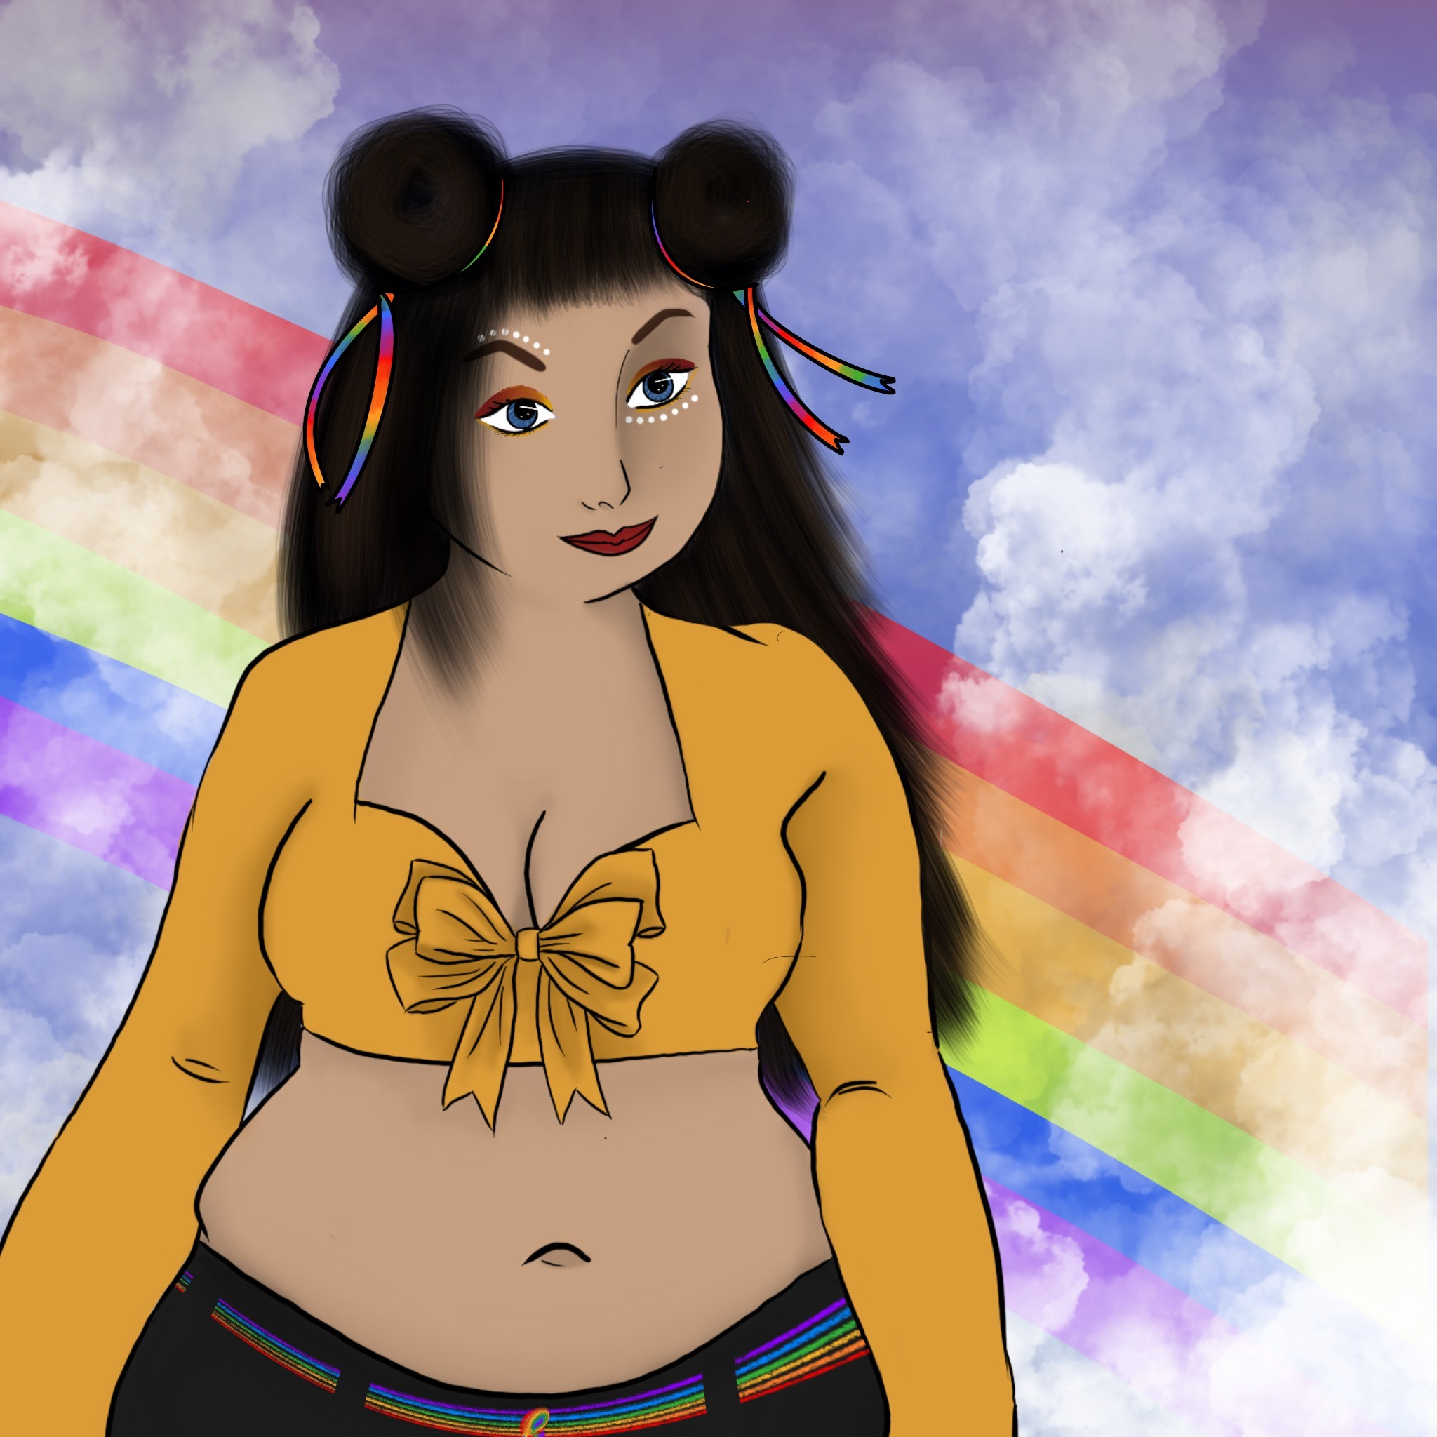
Project Aims
Understand factors which contribute to social emotional wellbeing (SEWB) and mental health in Indigenous LGBTQA+ youth
Learn how health services can support Aboriginal and/or Torres Strait Islander LGBTQA+ young peoples’ mental health and social emotional wellbeing
Understand similarities and differences in local community responses to the needs of Aboriginal and/or Torres Strait Islander LGBTQA+ young people
Co-design place-specific interventions to meet the mental health and social emotional wellbeing needs of Aboriginal and/or Torres Strait Islander LGBTQA+ young people

Slide 5
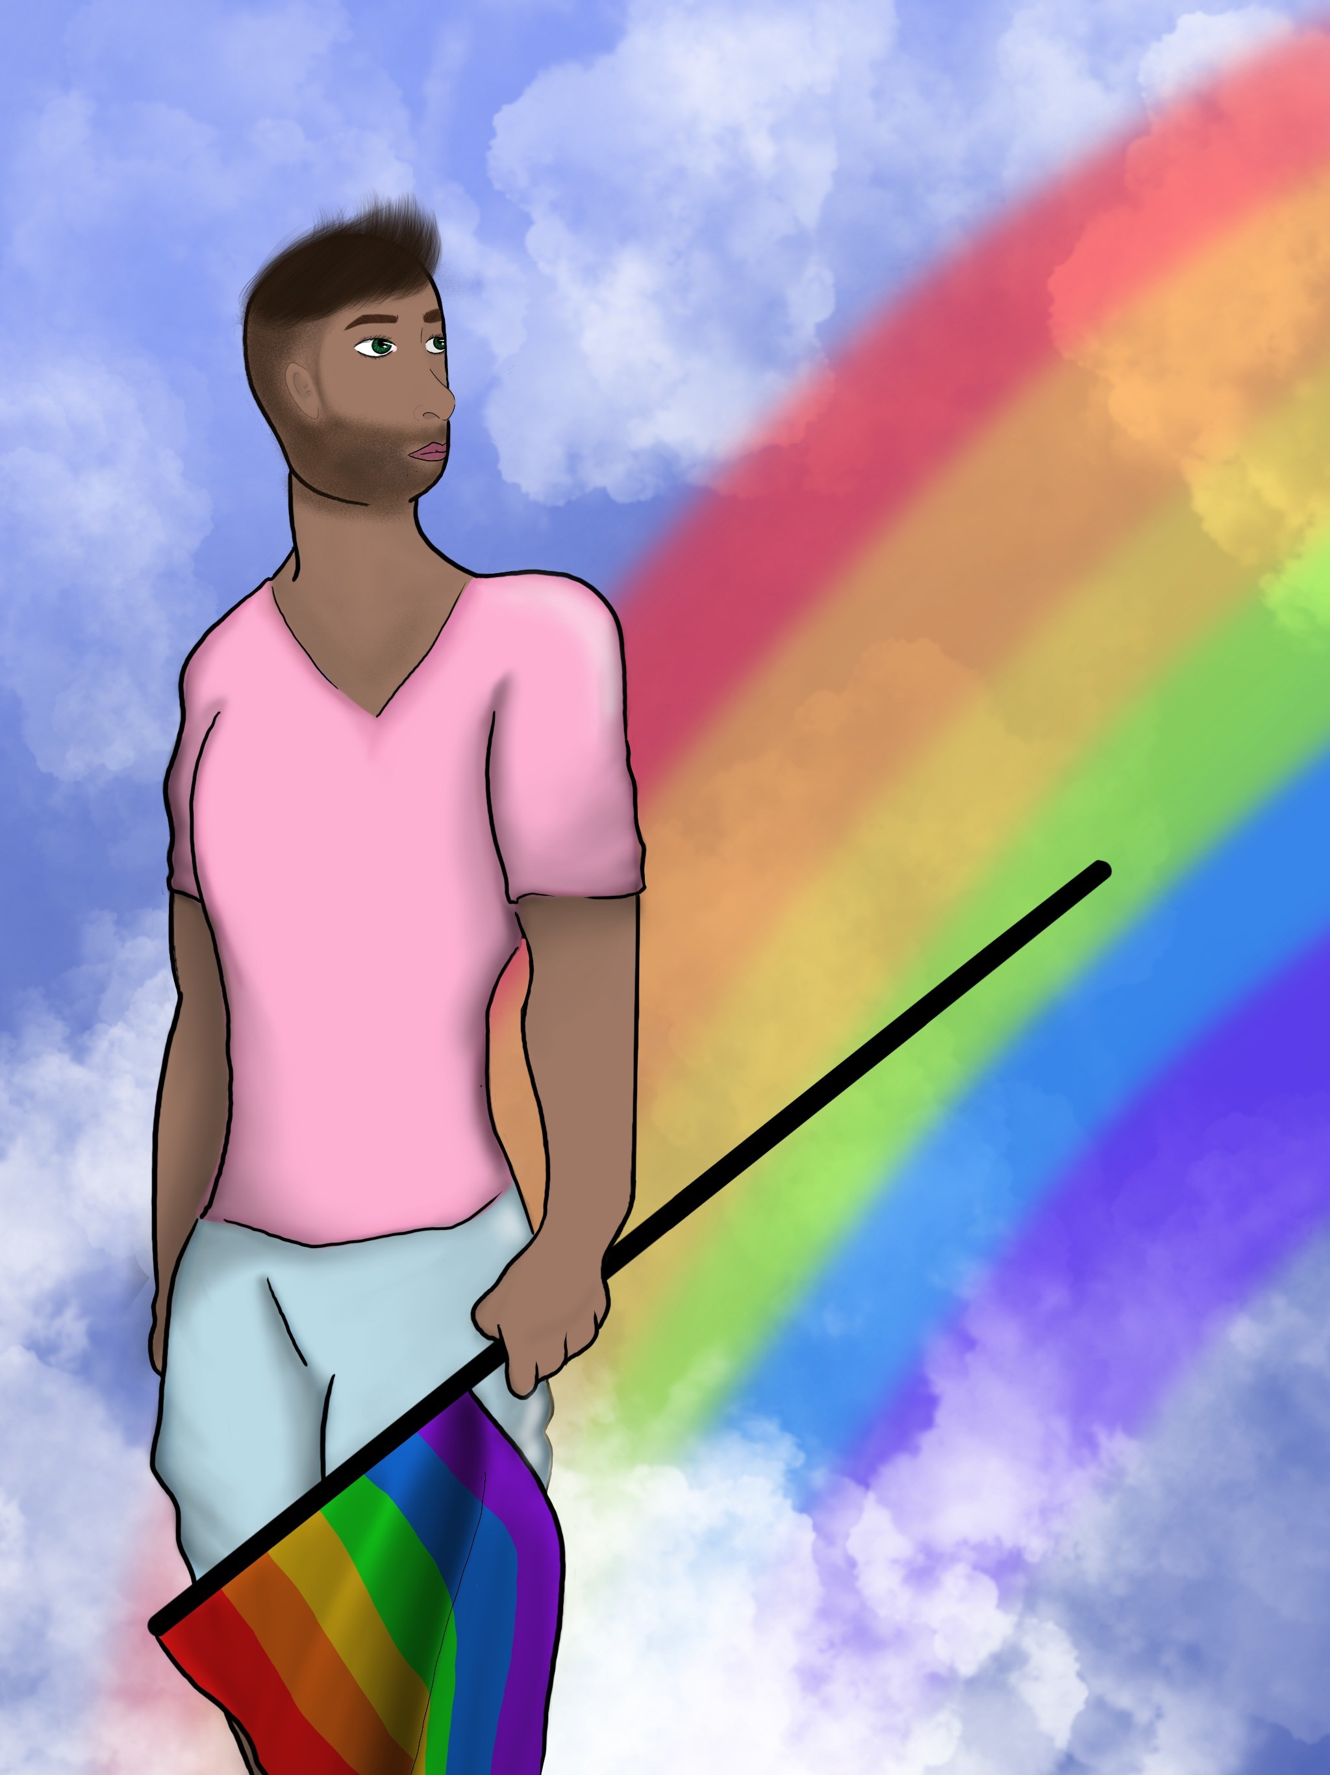
Project Design
Three-phase methodology: each phase builds on the learnings from the previous phases
Phase 1: Yarning groups and in-depth interviews in various sites around Australia. Currently happening in Perth and Greater Western Sydney.
Phase 2: National online survey of Aboriginal and Torres Strait Islander LGBTQA+ young people, based on results of Phase 1.
Phase 3: Co-designing possible interventions to improve the social emotional wellbeing and mental health of Aboriginal and Torres Strait Islander LGBTQA+ young people

Slide 6
Initial findings
We have currently completed 16 interviews and 1 yarning group
We will be presenting thematic analysis of first 8 interviews
Main themes:
  Family
  Identity formation
  Visibility
  Culture
  Navigating services
  Navigating the environment
  Mental health (participants reported depression, anxiety, social anxiety, panic disorder, borderline personality traits, suicidal ideation)
Notes:
So far we have had interviews with 16 young people all the way from 14 years-early 20’s.
We have had the chance to look over the first 8 transcripts (4 from Sydney, 4 from Perth). These are very initial findings, based on some of our teams’ reflections on reading the transcripts/running the interviews. We have shared these findings with our Youth Advisory Group and with the research participants, for their input.
In relation to our first project aim of understanding the SEWB of Indigenous LGBTQA+ youth, we see that acceptance by family of sexual or gender identity is key to SEWB. Most participants spoke about having anxiety about coming out to family and worried about rejection, although most had a positive experience. That is not to say however, that family are always supportive. Talking with participants also showed that is helps when parents/family members validate their acceptance of their child’s sexual orientation through everyday conversations.
Regarding risk factors for poor mental health, some participants reported experiencing mental health concerns, self harm, depression, and anxiety.
In terms of who is supporting young Indigenous LGBTQA+ people, this appears to be other Indigenous LGBTQA+ community members, which can sometimes be a burdensome task.
Minority stress refers to chronically high levels of stress faced by members of stigmatized minority groups. It came through in our interviews in terms on young people always checking their environment to see if it safe to be ‘out’.
Participants also reported experiencing bullying at school based on race and sexual orientation.

Slide 7
Family
Acceptance/rejection by family is an extremely important factor in determining mental health and wellbeing, identified by target group as a priority
Supportive family can mediate with the wider community
First-in-family has a different role to younger LGBTQA+ relatives
Anticipatory anxiety about ‘coming out’ to family
Will anticipate reaction based on family’s attitude to LGBTQA+ people and issues in everyday situations
Most participants were “really lucky” to be accepted by family, however some experienced denial or rejection
Even among accepting families, lack of education contributed to micro-aggressions
“My sister actually had a girlfriend and came out first…I got my sister to tell my mum. And she took it really well and said, “I love you and it’s okay. You can love whoever you wanna love.” I told my dad, which was a bit scary. And he said the same thing like, “It’s okay. I love you.”

Slide 8
Identity
Identity was more important to understanding of ‘self’ than experience
Frequently a process of exploration and self-acceptance
Did not often feel the Aboriginal and LGBTQA+ aspects of identity were expressed together positively, but opportunities to do so were empowering
“…[I] had a lot of fear and just really depressed at that time, but then after that, I realise now that I’m a bit – a lot more happier with myself and just – I don’t know – I guess not caring what people think…I was happier just being able to be who I am and not put on a mask to satisfy other people.”
“I’m proud. I’ve went to Mardi Gras last year like my first with being out and stuff. I was loud and proud…But I’ve always been proud of my culture too, always done school activities around it”
“And they [Aboriginal conference] had a gala dinner that was Mardi Gras themed, which was really fun. And we did a rainbow headpiece and it was really cool to see all these Pride flags and Aboriginal flags in the same room and amazing to celebrate that.”
Notes:
The construct of identity also comes through as a strong theme. All of the young people spoke about being proud in being Indigenous and LGBTQA+. The idea of ‘code-switching’ also came up, such as changing how one presents based on the immediate environment.
Full acceptance means being able to be open about all aspects of one’s identity.

Slide 9
Visibility
Lack of representation of Aboriginal and Torres Strait Islander LGBTQA+ people
Some participants’ felt alone and invisible, resulting in poor wellbeing
LGBTQA+ spaces are primarily white, meaning queerness is associated with whiteness
  This allowed participants’ queerness to be attacked on the basis of their Aboriginality, or their Aboriginality to be attacked on the basis of their queerness
“I always knew I was attracted to girls, but because there wasn’t any representation, I didn’t know it was possible.”
“I guess, knowing that you’re not the only one that felt that or is feeling that is comforting.”
“Yeah. Well, that’s the thing as well because I find that those spaces and the LGBTQI+ spaces here a very white, like I went to Pride on the weekend and my friend and I – she’s a person of colour but she’s not Aboriginal – walked into the place, there was this dance circle going on – it was the whitest shit ever. We had to go in there and show them how it’s done.”
Notes:
Another key theme linked to SEWB was a lack of representation of Indigenous LGBTQ+ people in services and the media. It was helpful to at least to see LGBT POC generally represented in media.
It should be noted that there was exclusion and racism experienced in queer spaces, and one participant noted that aboriginal community members can sometimes equate queerness with whiteness.

Slide 10
Culture
Rejection by community, in particular Elders, risks disconnection from culture
Hiding/suppressing LGBTQA+ identity within Aboriginal community
‘Going back in the closet’ when visiting rural community
Navigating gendered cultural protocols
  Influence of family can help or harm
Support from older community members
“…they told me that I wasn’t allowed back on the community because of it. Otherwise, they have the right to flog me. So, it’s just law, Aboriginal law. ….I guess what I seek from elders is approval. That’s a big thing for me and especially if you get to know them over a period of time and you tell them and they completely cut you off, you’re like: “Well, how am I meant to, I guess, gain that knowledge from them?”
“Culturally, it’s been a little bit conflicting for me because in my culture traditionally my mum wouldn’t be able to meet my partner…but that will be if my partner were a man.”
Notes:
One of the differences, of course, for Indigenous LGBTQA+ young people compared to other LGBTQA+ young people, is the need to understand how sexual and gender identity fit within cultural identity. Participant discussions suggested they had thought about this a lot. For example, one participant spoke of how to negotiate gender-based protocols for dating in her community.
Some participants also said they were more likely to not be so open about their sexual orientation when in their aboriginal community.
There were experiences of rejection from Elders based on sexual orientation, which affected a participants ability to connect with culture.
But, it is important to note that some communities/community members were accepting.
Participants also said it was helpful to see older LGBT aboriginal people, as it makes it known that being Aboriginal + LGBTQA+ is a ‘thing’.

Slide 11
Navigating services
Often preferred to rely on support from other community members
Preferred to see someone Indigenous, Queer or of colour, but must compromise with affordability and accessibility.
Will ‘suss out’ over time rather than immediately disclosing sexuality/gender
Confidentiality is a major concern when accessing services, in particular ACCHOs and AMSs
Services need to clearly communicate that they are LGBTQA+ friendly
Experiences of racism and transphobia in mainstream health services
Aboriginal organisations celebrating LGBTQA+ community have a positive impact on SEWB, especially when incorporating cultural activities
“…you can go to a GP, but it’s just general like it’s not for you, it’s for everyone. And you don’t know what you’re walking into. You don’t know if it’s gonna be safe for you.”
“I guess having someone that’s kind of like me in a way and that being able to relate to what they’re saying.”
Notes:
In terms of experiences with services, participants suggested that services need to clearly indicate they are LGBTQA+ friendly, for example, by displaying an ‘Ally’ or Pride symbol.
Confidentiality between clinician and patient around sexual and gender identity also flagged as important.
Last, it is important to note that Indigenous LGBTQA+ young people DO notice when a service is inclusive/is not inclusive. Many gave examples of how positive it felt when an Aboriginal-based organisation celebrating Pride activities and managed to weave this in with cultural activities.

Slide 12
Navigating The Environment
Minority stress: always checking whether the space is safe
In visiting services and in everyday life, Aboriginal LGBTQA+ young people use a variety of strategies to determine who will be a ‘safe’ person to engage with
“I’ve only told the girl that I work with and she’s from [location]. She’s Aboriginal. She knows I’m gay but the guys that I work with, I don’t know. It’s so awkward because they’re old men and they’re rough and things like that. They’re like manly men. So it’s awkward. And I don’t want them thinking that I have an attraction to them.”
“I guess the way that they – not so much how they behave, but how they, I guess, talk to someone.”
“I couldn’t tell any of my clients about, like, my gender…especially if I hear them making homophobic comments, just while I’m with them, it was like “I’m not gonna bring that up to them, like, I’m here for them, they’re not there for me,” so it was a bit – it just made me uncomfortable…I needed to be respected as well. So I was just like “no”, so now I’m looking for work.”

Slide 13
Bonus: some quick ways to improve your ability to support Aboriginal and Torres Strait Islander LGBTQA+ young people
Signal acceptance using visual imagery such as Pride flags, and speak positively about LGBTQA+ people and issues
Educate yourself on LGBTQA+ terminology
Integrate inclusive language into bureaucracy (e.g. gender:______ rather than M/F)
Allow time to build trust
Ensure confidentiality is respected and inform clients of their rights

Slide 14
Conclusion
Initial findings suggest a diverse range of experiences related to the social emotional wellbeing and mental health of Indigenous LGBTQA+ young people, which in some ways parallels international trends. The findings are not all negative, and there is an overwhelming degree of resilience present.
Aboriginal and Torres Strait Islander LGBTQA+ young people are more than the sum of their experiences
HOWEVER these results are preliminary. Data collection is ongoing.

Slide 15
Interested?
Interviews and yarning groups are ongoing in Perth and Sydney
The national survey will commence later this year
We’d love you to share the survey with your networks when it commences. Stay up to date by checking our website https://www.rainbowknowledge.org/
or follow Kulbardi Aboriginal Centre’s Facebook page https://www.facebook.com/kulbardiaboriginalcentre/?__tn__=%2Cd%2CP-R&eid=ARD4B0KzLA-6wrI0cH2vCQv1L7fP6Isr_B0xRfez8zKYupDTDYe8bM-FxtlnRHCZeeDcn-IkFiXyUCEl

Slide 16
Acknowledgements
Artist Shakyrrah Beck: “I’m 19 with two kids under 2 studying year 12 while doing art commissions on the side as both a way to calm myself and to support my family. I’m a Narungga woman but was welcomed in by the Kaurna people from when I was young and have grown up with them.”
Assoc. Prof Ashleigh Lin, Dr Yael Perry, Travis Talbott (TKI)
Prof Braden Hill (ECU)
Dr Karen Soldatic, Prof. Linda Briskman, Dr Kim Spurway, Mr William Trewlynn (WSU)
Youth Advisory Group https://www.rainbowknowledge.org/youth-advisory-group
Local Indigenous Governance Committees
Project partners

